Slide 1
NAT: network address translation A solution to ‘reuse’ the address space

Slide 2
PES Campus
MIT Campus
Internet
Campus #1
Campus #2
IIT Campus
Campus #3
Q.1. Is it possible to have the same address space e.g. 10.0.0.0/8 for all the 3 campuses ?
Q.2. Suppose PES campus is allotted an IP address 200.200.200.0/24 ( which means only 254 hosts can be connected ), is there any way to connect 1000 users?

Slide 3
Yes.. Possible
through Network Address Translation(NAT) mechanism

Slide 4
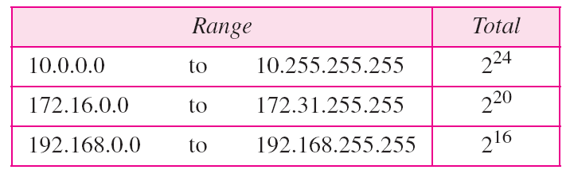
Basic principle of NAT
ICANN has declared following address space
as Private address space
Table Addresses for private networks
What is the meaning of Private address?
To be used in private campuses ….if any packet with the address listed in this space enters public internet, that packet will be discarded

Slide 5

NAT: network address translation
Private network using private address space
Public address allotted to the private campus
rest of
Internet
local network
(e.g., home network)
10.0.0/24
10.0.0.1
10.0.0.4
10.0.0.2
138.76.29.7
10.0.0.3
all datagrams leaving local
network have same single source NAT IP address: 138.76.29.7,different source port numbers
datagrams with source or
destination in this network
have 10.0.0/24 address for
source, destination (as usual)

Slide 6
NAT: network address translation
motivation: local network uses just one IP address as far as outside world is concerned:
range of addresses not needed from ISP: just one IP address for all devices
can change addresses of devices in local network without notifying outside world
can change ISP without changing addresses of devices in local network
devices inside local net not explicitly addressable, visible by outside world (a security plus)

Slide 7
NAT: network address translation
implementation: NAT router must:
outgoing datagrams: replace (source IP address, port #) of every outgoing datagram to (NAT IP address, new port #)
. . . remote clients/servers will respond using (NAT IP address, new port #) as destination addr
remember (in NAT translation table) every (source IP address, port #) to (NAT IP address, new port #) translation pair
incoming datagrams: replace (NAT IP address, new port #) in dest fields of every incoming datagram with corresponding (source IP address, port #) stored in NAT table

Slide 8
NAT: network address translation
NAT translation table
WAN side addr LAN side addr
2: NAT router
changes datagram
source addr from
10.0.0.1, 3345 to
138.76.29.7, 5001,
updates table
1: host 10.0.0.1
sends datagram to
128.119.40.186, 80
138.76.29.7, 5001 10.0.0.1, 3345
…… ……
S: 10.0.0.1, 3345
D: 128.119.40.186, 80
10.0.0.1
1
2
S: 138.76.29.7, 5001
D: 128.119.40.186, 80
10.0.0.4
10.0.0.2
138.76.29.7
S: 128.119.40.186, 80
D: 10.0.0.1, 3345
4
S: 128.119.40.186, 80
D: 138.76.29.7, 5001
3
10.0.0.3
4: NAT router
changes datagram
dest addr from
138.76.29.7, 5001 to 10.0.0.1, 3345
3: reply arrives
dest. address:
138.76.29.7, 5001

Slide 9
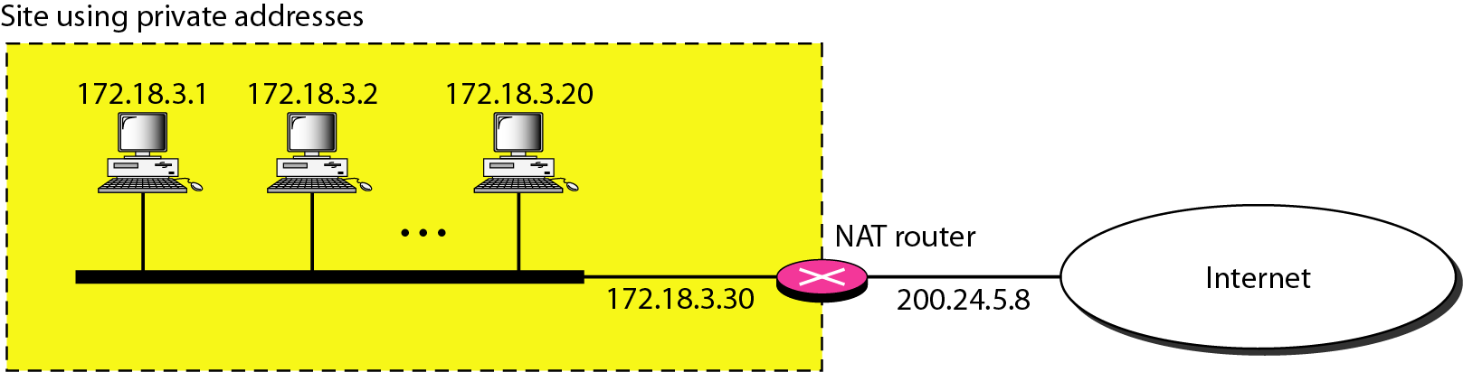
Figure 19.10 A NAT implementation

Slide 10
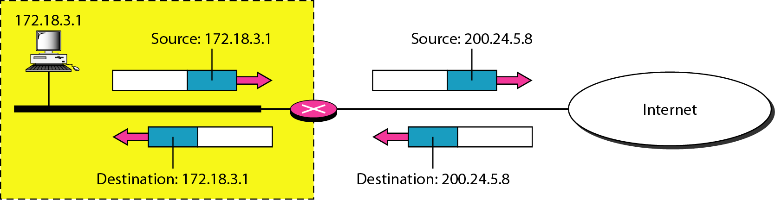
Figure 19.11 Addresses in a NAT

Slide 11
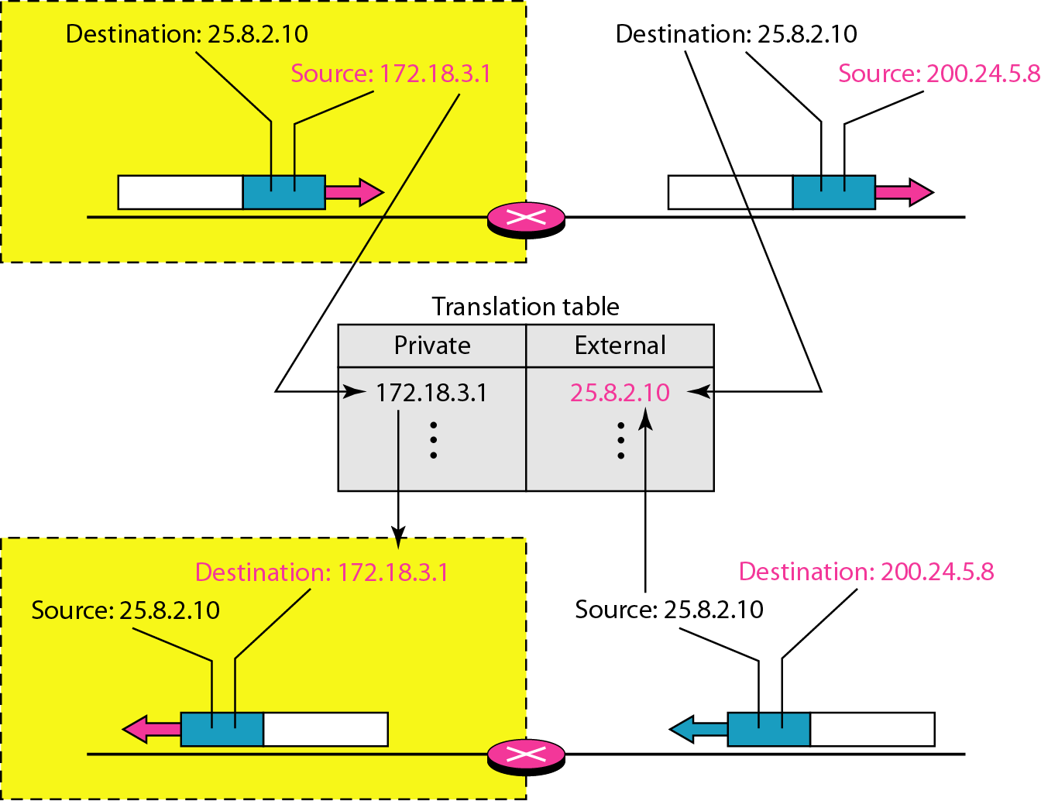
Figure 19.12 NAT address translation

Slide 12
NAT: network address translation
Both IP address and Port ( Process) address are translated when a datagram leaves NAT and vice versa.
16-bit port-number field:
60,000 simultaneous connections with a single LAN-side address!

Slide 13
NAT: network address translation
?!!Did you understand how NAT is the answer for the questions listed in the beginning of this presentation ?!!

